Slide 1
Digitalization in Private Banking
Suresh Marpu

Slide 2
Objective
Why Digitalization?
Key Digital trends in Singapore private banking
UX research and Prioritization
Implementation approach

Slide 3
Why Digitalization
Competition
Fintech’s are entering the traditional banking market, using digital and mobile technology to attract new customers.
Sales & Cost
Growth is expected when banks offer digital products, more efficient operations and the other reason to cut the costs incurring due to legacy platforms.
User Experience
Customers are demanding more digital products from their banks. Research suggest that customers will switch banks if they are unhappy with digital banking services.
Future Ready
We need to look to the future, and how we can leverage innovations to exceed our clients’ ever-growing expectations
Efficiency
Digitalization has brought around enhanced efficiency in banking processes

Slide 4






Key Digital trends in Singapore
AI
AI and machine learning will result in real-time financial recommendations.
Integrated AI experience driving better services and results.
Fraud detection.
Blockchain
Real-time settlements.
More secured and low-cost.
A shared Blockchain platform is efficient method for banks to collect ,store , validate customer information
Cloud
Scale computing as needed
Focus on services
Build resilient operations.
Data
Understand client better.
Provide personalized products
Generate insights
Open Banking
Integrated 3rd party product offering.
Improved customer experience
Revenue opportunity
Automation
Accelerated digital transformation.
Better customer experience
High operation efficiency.

Slide 5
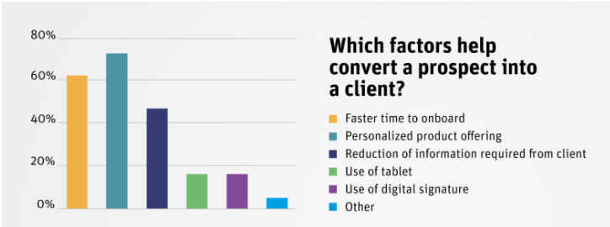
Digital feature that the bank should implement
Understanding
the user
According to above study ,the priority should be client onboarding, which needs to be addressed first

Slide 6
Implementation Approach
The pros and cons of “Build vs Buy’ onboarding application .
Build in-house
Pros:
Can be customized according to the bank needs.
No external dependency
Cons:
Required time , money and effort
Need Engineering skills
May or may not be able to integrate with 3rd party software.
Buy
Pros:
Plug and play with few configuration changes..
May be cheaper compare to in-house re-engineering.
Tested software , can try different products which caters to the bank requirements and future needs.
Cons:
Creates dependency with vendor and their solutions.
Not necessarily be able to integrate with existing software.
Training needs to perform tasks.
Build In-house
Buy
Recommendation: There is no single universal solution but given that the private bank “ABC” has no digital offerings and exploring their Digitalization options, I would recommend to build in-house product base. The digital transformation should start with agile mindset with engineering skill set which are required to compete with fintech’s and competitors in long run. It’s a long journey but have to start at some point.

Slide 7
Focus on Private banking or expand offerings to mass affluent
The mass affluent banking customer is a segment expected to grow by double digits in 2021.
These new millionaires will fall into mass affluent WM segment and eventually they fall into HNW if they continue to raise.
Many customers prefer one-stop banking.
Fintech Digital wealth management banks are aiming this sector with their digital offerings.
Leverage new digital transformation technical stack to offer mass affluent.
Use Digital onboarding to make a prospect to client.
Offer customized products with the help of Analytics and AI.
Use open banking as an opportunity to offer products outside their product offering and maintain the huge client base.

Slide 8
Thank you!

